Slide 1
Chapter - 4
The Research Process for Applied and Basic Research
The Broad Problem areas
Preliminary Data Collection
Some Information Vital for Research
Literature Survey
  Reasons for literature survey
  Conducting the Literature survey
  Identifying the relevant sources
  Extracting the relevant information
Writing up the literature survey or the literature review
Problem
Writing Up The Definition
Managerial Implications
Ethical Issues

Slide 2
Self study Reading assignment
APPENDIX
Online data bases
Bibliographical Indexes
Referencing in the APA Format.
Referencing and Quotations in the Literature Review Section

Slide 3
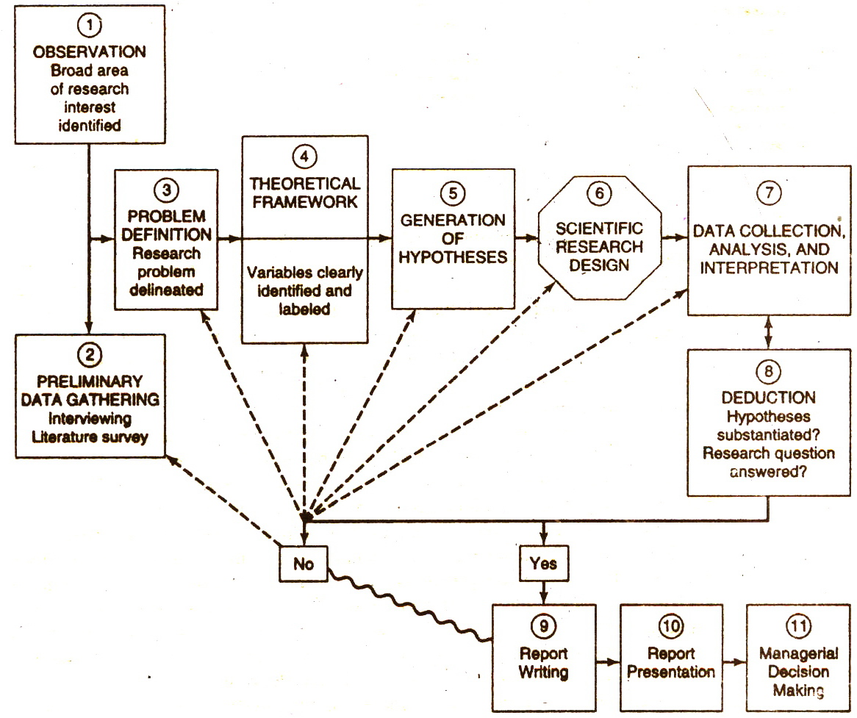
The Research Process

Slide 4
Broad Problem Areas
The specific issues that need to be researched might pertain to :
Problems currently existing in an organizational setting that need to be solved
A conceptual or theoretical issue that need to be improved
Areas that a manager believes need to be tightened up for the basic researcher to understand certain phenomena
Some research questions that a basic researcher wants to answer empirically.

Slide 5
Preliminary Data Collection
Nature of data to be gathered
The nature of information needed by researcher for the purpose could be broadly classified under three headings:
Background information of the organization-that is, the contextual factors.
Managerial philosophy, company policies, and other structural aspects.
Perceptions, attitudes, and behavioral responses of organizational members and client systems (as applicable).

Slide 6
Background information of the Organization
The origin and history of the company-when it came into being, business it is in, rate of growth, ownership and control, and so on.
Size in terms of employees, assets, or both.
Charter-purpose and ideology.
Location-regional, national, or other.
Resources-human and others.
Interdependent relationships with other institutions and the external environment.
Financial position during the previous to years, and relevant financial data.

Slide 7
Information on structural factors and management philosophy
Questioning about managerial and company philosophy offers and excellent idea of the priorities and values of the company, as for example:
whether product quality is really deemed important by the company or if only lip service is being paid to the concept;
whether the company has short-term or long-term goals;
whether controls are so tight that creativity is stifled, or so loose that nothing gets done, or if they are conducive to good performance;
whether the company always wants to play it safe or is prepared to take calculated risks; and
whether it is people-oriented or solely profits-oriented.

Slide 8
Information on structural factors and management philosophy (contd..)
Below are some of the structural factors:
Roles and positions in the organization and number of employees at each job level.
Extent of specialization.
Communication channels.
Control systems.
Coordination and span of control
Reward system
Workflow systems and the like.

Slide 9
Perceptions, attitudes and behavioral responses
An understanding of the attitudinal and behavioral reactions of organizational members is often very helpful in arriving at a precise problem definition.
Attitudinal factors comprise people’s beliefs about and reaction to the following:
Nature of the work.
Workflow interdependencies.
Superiors in the organization.
Participation in decision making.
Client systems.
Co-workers.
Rewards provided by the organization, such as pay raises and fringe benefits.

Slide 10
Perceptions, attitudes and behavioral responses (contd..)
Opportunities for advancement in the organization.
Organization's attitudes toward employees; family responsibilities
Company’s involvement with community, civic, and other social groups.
Company’s tolerance of employees’ taking time off from the job.
Behavioral factors include actual work habits such as industriousness, extent of absenteeism, performance on the job and the like.

Slide 11
Literature Survey
Literature survey is the documentation of a comprehensive review of the published and the unpublished work from secondary sources of data in the areas of specific interest to the researcher.
Reasons for the literature survey:
Important variables that are likely to influence the problem situation are left out of the study.
A clear idea emerges as to what variable would be most important to consider (parsimony), why they would be considered important, and how they should be investigated to solve the problem. Thus, the literature survey helps the development of the theoretical framework and hypotheses for testing
The problem statement can be made with precision and clarity.
Testability and replicability of the findings of the current research are enhanced.

Slide 12
Literature Survey (contd..)
One does not run the risk of “reinventing the wheel’ that is, wasting efforts on trying to rediscover something that is already known.
The problem investigated is perceived by the scientific community as relevant and significant.
Conducting the survey
The first step in this process involves identifying the various published and unpublished materials that are available on the topics of interest, and gaining access to these
The second step is gathering the relevant information either by going through necessary materials in a library or getting access to online sources
The third step is writing up the literature review

Slide 13
Literature Survey (contd..)
Identifying the relevant sources
The bibliographic databases which display only the bibiliographic citations, that is, the name of the author, the title of the article (book), source of publication, year, volume and page number. These have the same information as found in the bibliographic index books in libraries, which are periodically updated and include articles published in periodicals, newspapers, books and so on.
The abstract databases which in addition provide an abstract or summary of the articles.
The full-text databases, which provide the full text of the article

Slide 14
Literature Survey (contd..)
Extracting the relevant information
Access:
Accessing online system and getting printout of all published works in the area of interest from a bibliographical index.
Observe:
A glance at the titles of the articles or books will indicate which of these may be relevant.
Abstract study:
The abstracts of articles that seem to be relevant can be obtained through online system. This will give idea about which articles need to be looked into in depth.

Slide 15
Literature Survey (contd..)
Full Articles:
After studying the abstracts chosen in step 3, obtain full text of relevant articles. While studying the article systematically note down the following:
    Information on problem that was researched
    The design details of the study
    Ultimate findings
This facilitates the writing of literature review with minimum disruption and maximum efficiency.

Slide 16
Literature Survey (contd..)
Writing up the literature review
The documentation of the relevant studies citing the author and the year of the study is called literature review or literature survey.
The purpose of the literature survey is to identify and highlight the important variables, and to document the significant findings from the earlier research that will serve as the foundation for theoretical framework and building hypotheses.
Literature survey should bring together all relevant information in logical manner instead of presenting information in bits and pieces. A good literature survey leads to a good problem statement.
There are several accepted methods of citing references in the literature survey section and using quotations such as:
  The publication manual of the American Psychological Association (APA) 2001
  The Chicago manual of style 1993
  Turabian’s manual for writers 1996

Slide 17
Literature Survey (contd..)
One important benefit driven from a well written literature survey section is that the researcher would be able to delineate a logical, well defined and sharply focused problem for research investigation
Reading Assignment/Self Study: Example of two literature surveys
Example 4.1 &4.2 pp. 67 & 68

Slide 18
Problem Definition
After the interviews and literature review the researcher is in a position to narrow down the problem from its original broad base and define the issue of concern more clearly.It is critical that the problem be unambiguously identified and defined.
A“’ problem” could simply indicate an interest in an issue where finding the right answer might help to improve an existing situation.
Thus, it is fruitful to define a problem as any situation where a gap exists between the actual and the desired ideal states.
Problem definition could encompass both existing problem in a current setting as well as the quest ideal states in organizations.

Slide 19
Problem Definition (contd..)
Important: It is very important that :
  Symptoms of problem are not defined as the real problem
  Finding the “ right answer to the “ wrong problem definition will not help.
  Identification should be made between Antecedents, the real problem, or the consequences.
Example:- Low Morale and Motivation
  Real problem is low morale and motivation
  Consequence (effect ) low production
  Antecedents ( i.e. the contributing factors ) non Recognition of employees efforts.

Slide 20
Problem Definition or problem Statement
A clear, precise and succinct statement of the questions or issues that is to be investigated with the goal of finding an answer or solution. As mentioned earlier problem definition could pertain to:
Existing business problem where a solution is needed.
Situation that may not pose any current problem but the manager feels have scope for improvement.
Areas where some conceptual clarity is needed for better theory building, or
Situations in which a researcher is trying to answer a research question empirically.
Self reading assignment:-( Examples of Well Defined Problems. pp. 70-71)

Slide 21
Managerial Implications
  Managers sometimes look at the symptoms.
  Understanding Antecedents-problem-consequences sequence help a great deal in understanding and defining a problem.
  Awareness of information services and ability to obtain access to the requisite information is a great assets to the manager.

Slide 22
Ethical issues in the preliminary stages of investigation
Once a problem is sensed and an investigation is decided on, it is necessary to:
Inform all employees, particularly those who will be interviewed.
Letting them know that research is intended to help them in their work environment.
Eliminate unpleasant surprises.
Ensure that their responses will be kept confidential.
Avoid obtaining information through deceptive means at all costs.
( In essence, employers have the right to gather information relating to work, and employees have the right to privacy and confidentiality. )

